Slide 1

CS 513 B – KDD final PROJECT Forecasting Cancellation Flags: A Data-driven Approach to Hotel Reservation Cancellation Prediction Group 1
TEAM MEMBERS:
1. Naveen Mathews Renji
2. Aatish Kayyath
3. Madhura Shinde
4. Abhishek Kocharekar

Slide 2

cONTENTS
PROBLEM STATEMENT
DATASET
DATA DESCRIPTION
DATA PRE-PROCESSING
PROPOSED METHODOLOGY
CLASSIFICATION MODELS

Slide 3
Problem statement
The high rate of cancellations and no-shows in online hotel reservations has become a challenge for hotels as it impacts their revenue and occupancy rates. While customers benefit from the flexibility of free or low-cost cancellations, hotels have to deal with the revenue-diminishing effect of empty rooms. Hence, there is a need to explore strategies that can help hotels reduce cancellations and no-shows while maintaining customer satisfaction and loyalty. Therefore, the problem at hand is to predict the cancellation flag of a hotel booking based on a set of features, in order to assist hotels in managing their resources and revenue more efficiently.

Slide 4
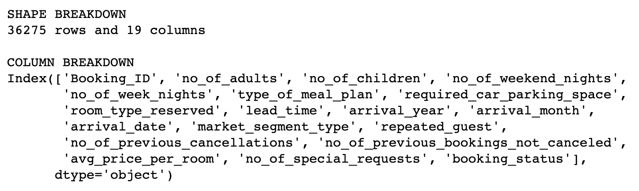
DataSET

Slide 5
Pre-Processing the Dataset
Convert "booking_status” as {"Not_Canceled": 0, "Canceled": 1}
Performed One Hot encoding for non-numerical columns - ['type_of_meal_plan', 'room_type_reserved', 'market_segment_type', 'season_group', 'price_per_room_group’]
There were no missing values
Performed Z-score outlier removal and reduced the number of rows from 36275 to 24752

Slide 6
DIFFERENT CLASSIFICATION MODELS
K-NEAREST NEIGHBOUR
GRADIENT BOOSTING
ADABOOST
LOGISTIC REGRESSION
DECISION TREE
LightGBM
CatBoost
XGBoost
SVM
ANN

Slide 7
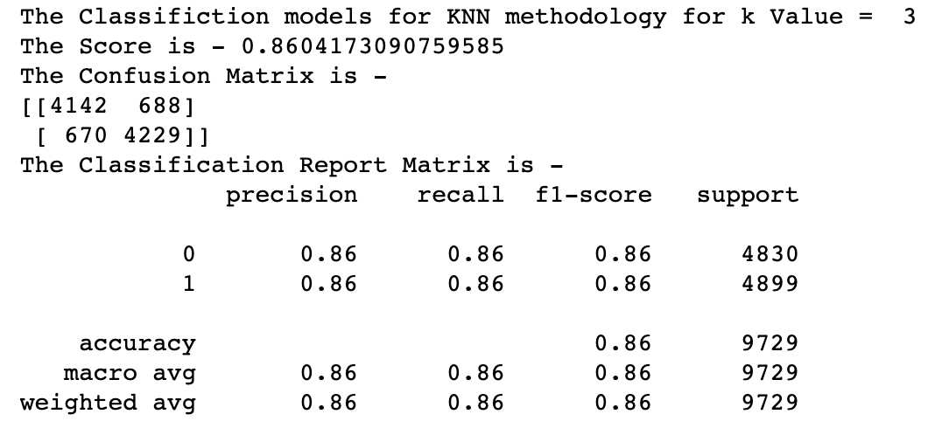
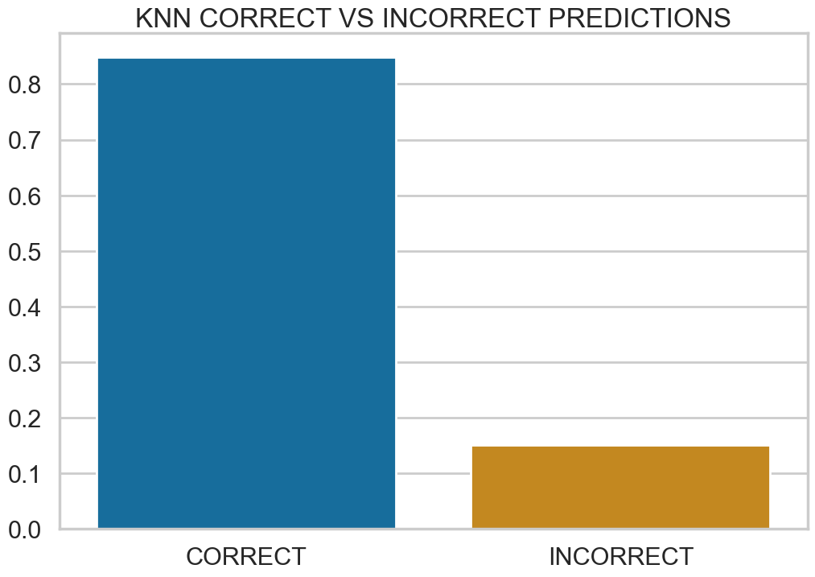
K-Nearest neighbour

Slide 8
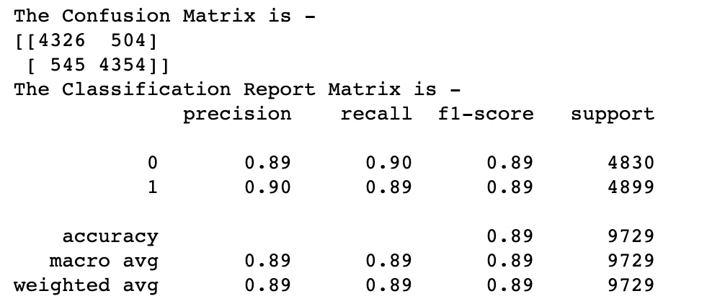
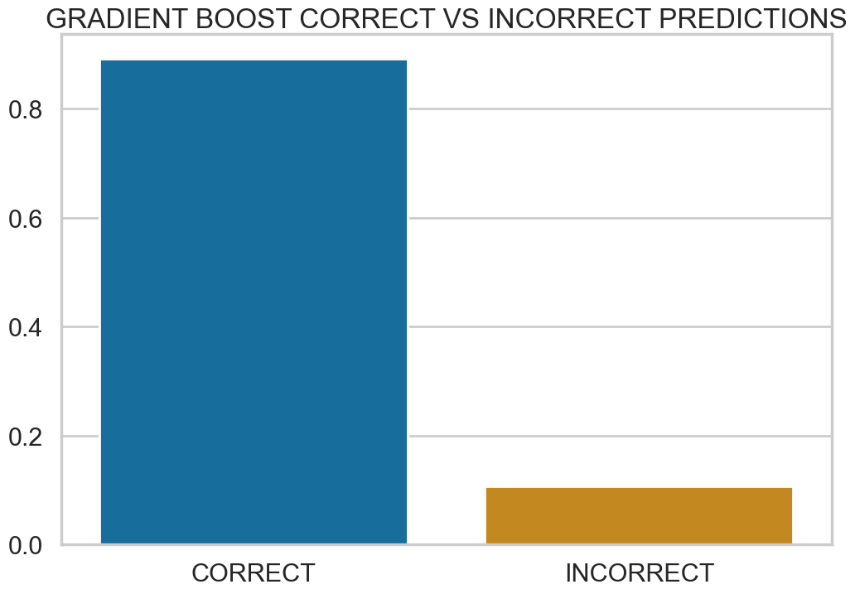
Gradient boosting

Slide 9
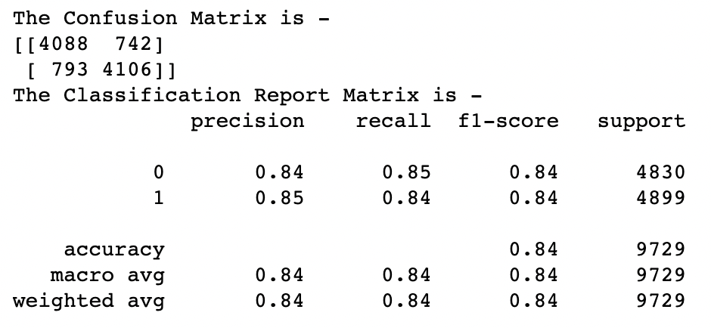
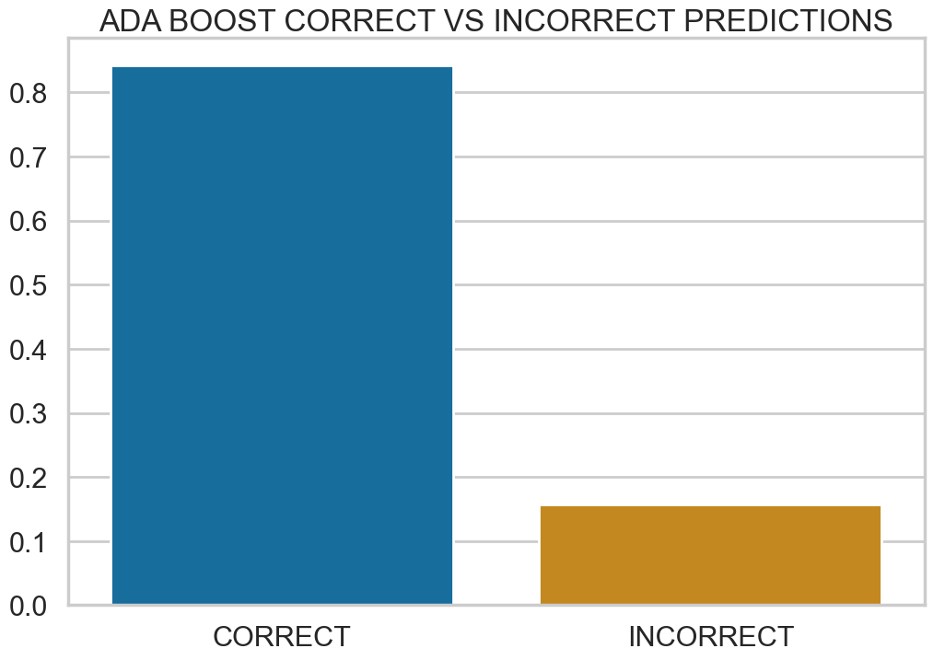
adaboost

Slide 10
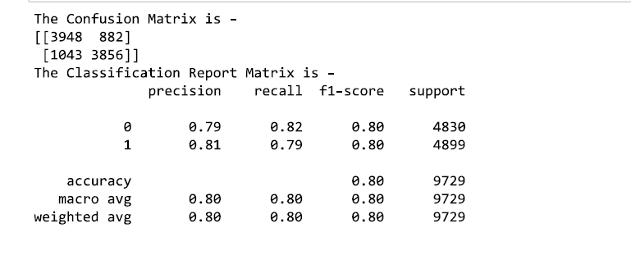
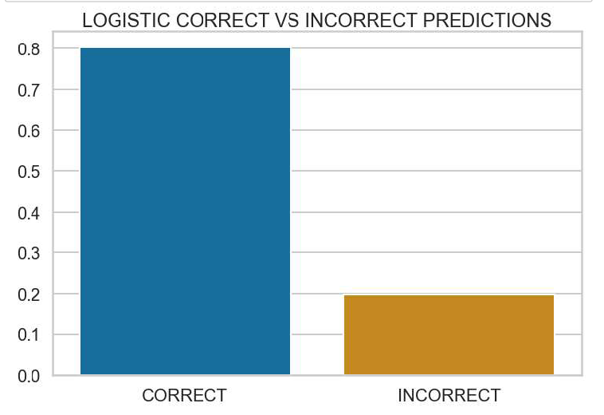
Logistic regression

Slide 11
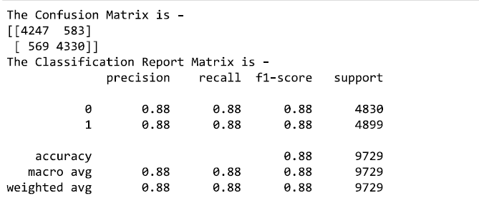
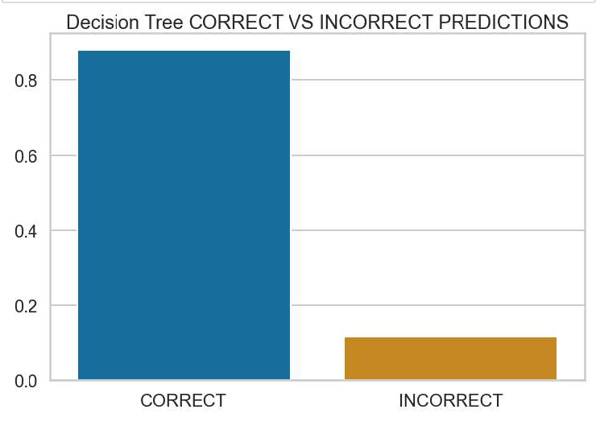
Decision tree

Slide 12
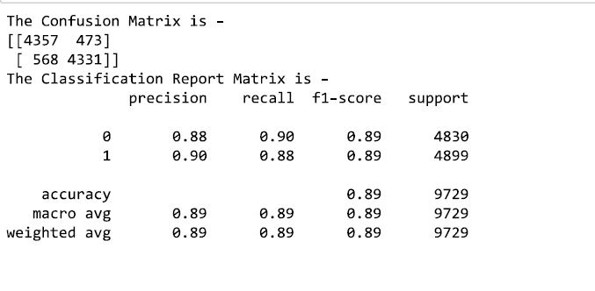
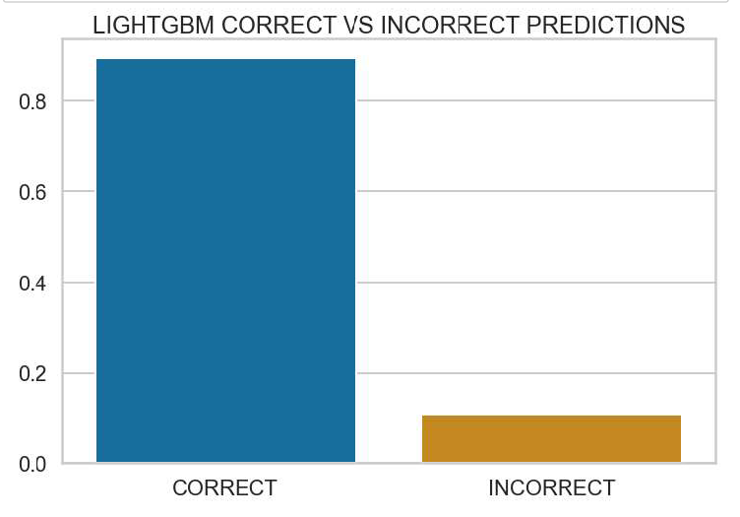
lightgbm

Slide 13
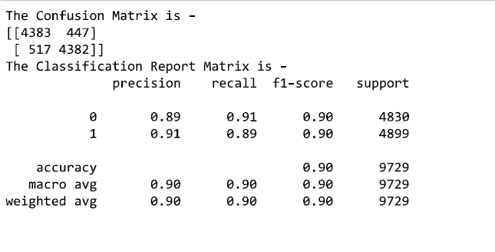
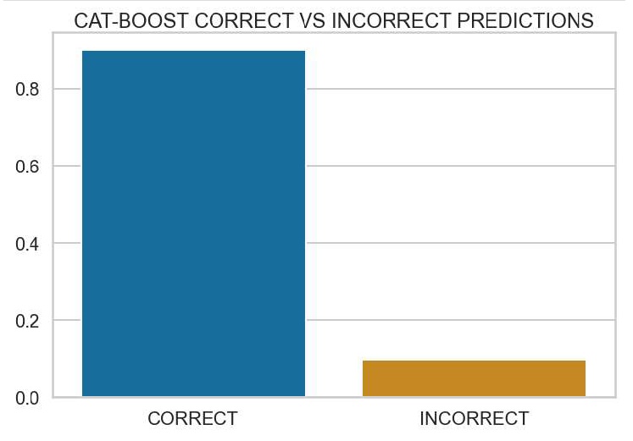
catboost

Slide 14
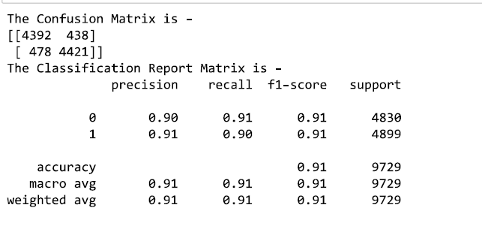

xgBoost

Slide 15

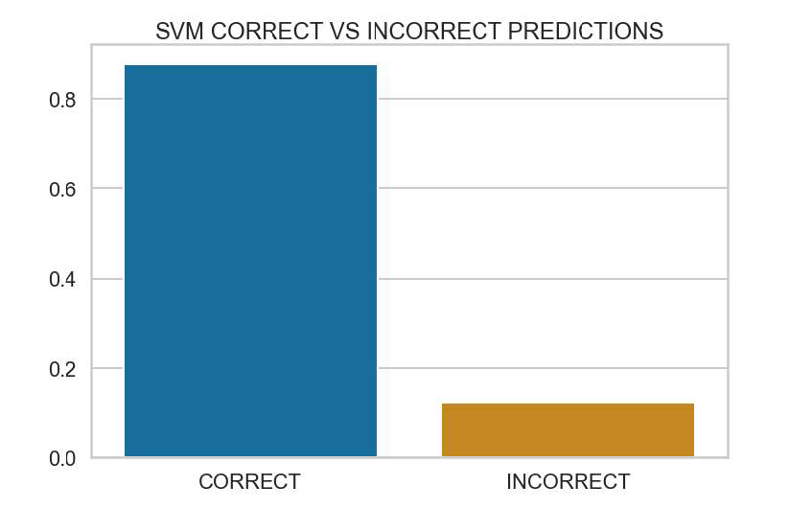
svm

Slide 16
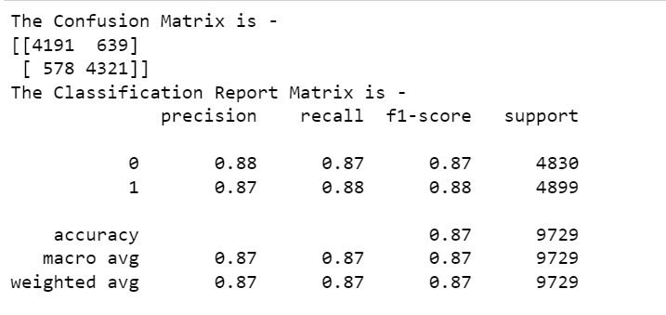
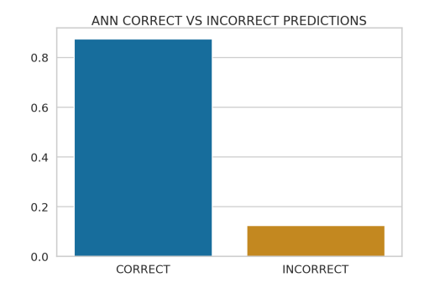
ann

